Slide 1


PM Vishwakarma
Registration on portal - Application Process Flow

Slide 2




ProcessProcess of Registration of applicants for PM Vishwakarma – PM Vishwakarma Portal
SLIDE - 01
1
2
Open the website https://pmvishwakarma.gov.in/ and click on the“login” drop down on right hand corner
From the Login dropdown menu, select CSC login, then select the "CSC- View E- Shram Data" option
Using CSC Id and password, users can see E-Shram registered applicant details. So they can contact those applicants and register them in PM Vishwakarma
CSC has to approach the proposed applicants available in E-shram data and CSC can also source the application from market independently
CSC will ask the artisans/ craft people to arrange (i) Aadhaar details, (ii) Ration Card Details, (iii) Aadhaar linked Mobile Number, (iv) Saving Account details (v) Aadhaar of family members
Registration Process begin with CSC/VLE after applicants arrange the required information

Slide 3



ProcessProcess of Registration of applicants for PM Vishwakarma – PM Vishwakarma Portal
SLIDE - 02
2
To register Artisans in PM Vishwakarma, CSC Users need select the "CSC- Register Artisans" option from the Login drop down on PM Vishwakarma portal
Log in using CSC User Name and Password
Select ‘No’ in “Is there any government employee within your family?”and “Have you availed credit/loan facility under similar schemes of central government or state government for self-employment/business development, e.g. PMEGP in the past 5 years or have outstanding loan under PM SVANidhi or Mudra?” and click on ‘Continue’ button
“Enter Aadhaar Linked Mobile Number” and enter Aadhaar Number of Artisans, do OTP verification
Proceed to do Aadhaarauthetication using BIOMETRIC
EKYC verification
Fill the Reg Form. Name, Father/ Spouse name, DOB & Gender will be automatically fetched from Aadhaar through API. Select
marital status
Category (Gen/SC/ST/OBC)
Divyangjan or not
whether the artisan doing business in same state or not
minority category.
3
In the Family detail section, if ration card number is linked with Aadhaar number then ration card number & family details will be auto populated, else enter ration card number to fetch family details, if ration card not available then add family information manually.
In the Contact Detail Section, the Mobile Number and Aadhaar Number will be auto-filled. Enter the Pan Card Number, if available.

Slide 4
ProcessProcess of Registration of applicants for PM Vishwakarma – PM Vishwakarma Portal
SLIDE - 03
3
4
In the Aadhaar Address Section, the Aadhaar address, State, District, and Pin Code will be auto-filled. if the Aadhaar address is same as the Current Address, click on "Same as Aadhaar address." And select whether the artisan comes under gram panchayat or not, if yes then select block and gram panchayat
If artisans belong to urban area select No in “Do You come under Gram Panchayat” and select ULB Name
In the Aadhaar Address Section, If the Aadhaar address is different, select "Other" and select whether the artisans come under gram panchayat or not and enter current address detail.
In the Profession/Trade Details Section, select the Artisan's Profession/Trade Name. Then need to declare that his/her profession/ trade is family profession and select business address, if the business address same as Aadhaar then select “Same as Aadhaar Address”, if same as current address then select “Same as Current Address”,
if business address is different than Aadhaar and current address then select Other option and enter business address

Slide 5
ProcessProcess of Registration of applicants for PM Vishwakarma – PM Vishwakarma Portal
SLIDE - 04
4
5
In the Bank Detail Section, select the Artisan's Bank Name, enter the IFSC Code, the Bank Branch Name will auto populate, and enter the Account Number and confirm it by re- entering the account number
In the Credit Support Section, select whether the Artisan requires Credit Support (Yes or May be later), and if credit support is required, enter the amount up to Rs. 1,00,000. If artisans want to take loan in same bank branch, then in preferred bank/ branch to take loan, select same as existing bank account branch.
Minimum loan is kept at Rs. 50,000.
Else if artisans want to take loan from different bank branch then select other and select bank and branch from where artisans want to take loan. Select purpose of loan and
In existing loan outstanding section, enter information if any and enter total monthly family income.
In the Digital Incentive Section, select whether the Artisan has any UPI Id, select Yes or No. If Yes, provide the UPI Id details. Enter the UPI ID linked mobile number if available.
If the answer is No, then QR code and VPA will be created by Digital Payment Agreegators, free of cost.
In the Skill Training Section and Tool kit section, read and understand the scheme component benefits
In the Marketing Support Section, select different Marketing-related support benefits available under this scheme

Slide 6
ProcessProcess of Registration of applicants for PM Vishwakarma – PM Vishwakarma Portal
SLIDE - 05
5
6
Accept the Declaration and Terms and Conditions
After entering all the required information, click on the Submit Button. A Registration Number will be generated on screen and SMS will flow to the beneficiary
Application will flow to Gram Panchayat /ULB for 1st level of verification

Slide 7


Processing of Registered Applications by Gram Panchayat/ULB and DM and DFO on PM Vishwakarma portal
SLIDE - 06
6
Gram Panchayat/ ULB Users Go to Registration Applications module in Portal
Gram Panchayat/ ULB marks it as ‘Recommended” or “Not Recommended”
Only Recommended by Gram Panchayat/ ULB applications moves to DM user
DM Processes the
Recommended application by marking it as “Recommended” or “Not Recommended”
Recommended by DM applications, move to DFO for their Approval and Rejection
About Verification stages
1st level of verification will be done by Gram Pradhan/ ULB
2nd Level of verification will be done by DM/ DC (District Implementation Committee)
3rd Level of verification will be done by DFO (Screening Committee)
“Not Recommended” by Gram Panchayat/ ULB Applications can be re- applied by Artisans
Approved Registration No. communicated to Artisans via SMS and Registration Certificate and ID will be generated and available under applicants user login.
7

Slide 8
Journey on PM Vishwakarma portal
Step 1: Beneficiary enrols
Step 2: Three-stage verification at Panchayat/ ULB, District and State level
Details forwarded to Digital Payments Aggregators for enabling Digital Transactions
QR Code and UPI provided to beneficiaries
Beneficiary activates and uses QR Code/ UPI in transactions
Details shared with NPCI and transactions reported by NPCI to MoMSME
Beneficiaries receive incentive
@ Re 1 per transaction
Beneficiary receives PM Vishwakarma Certificate and ID Card
Beneficiary details forwarded to MSDE
Beneficiaries receive Toolkit Incentive/ Toolkit @Rs 15,000
On sanction Beneficiary receives 1st loan tranche of Rs 1 lakh
Credit Information Report & Udyam Assist Certificate provided to bank
5 day Basic Skill Training and Certification
Application details for 1st Tranche of Loan upto Rs 1 Lakh forwarded to Bank
Banking details forwarded to NPCI for account validation
Beneficiary repays the 1st Loan Tranche
15 days or more Advanced Skill Training and Certification
Beneficiary receives Marketing Support
Beneficiary receives 2nd Loan Tranche of Rs 2 Lakh
Actively uses Digital Transaction

Slide 9
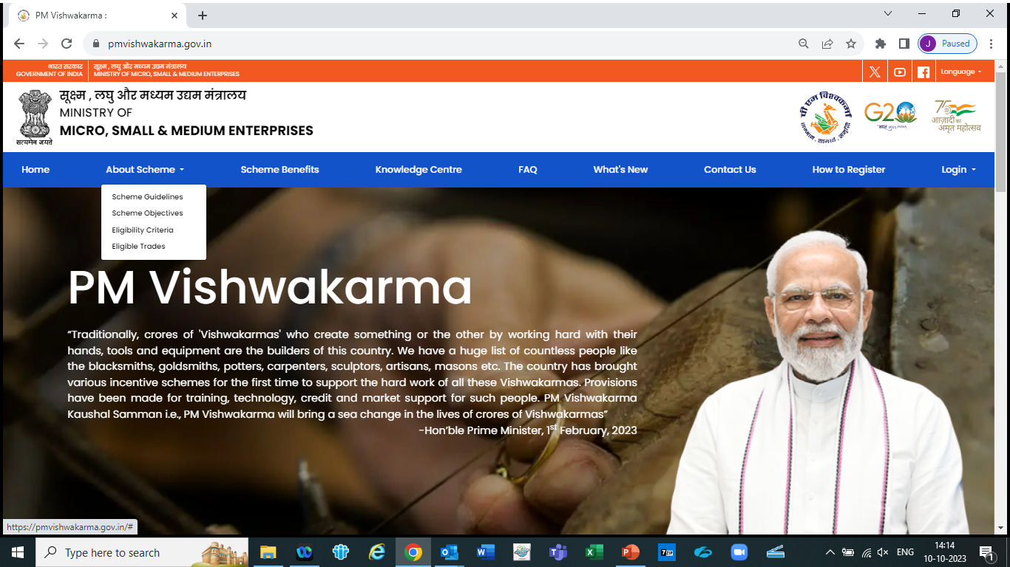

Slide 10
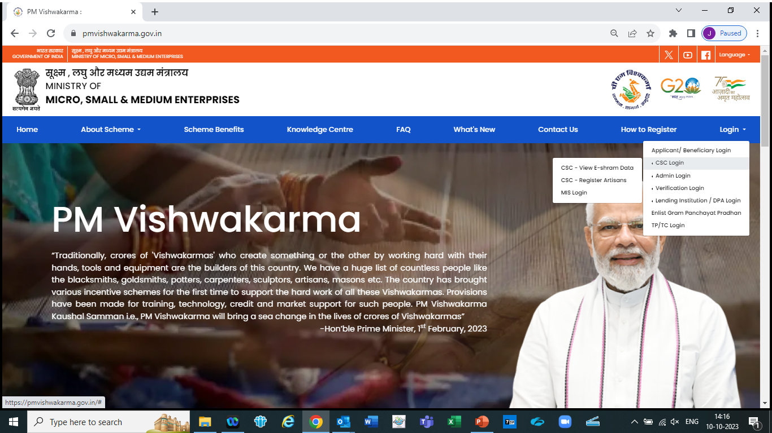

Slide 11
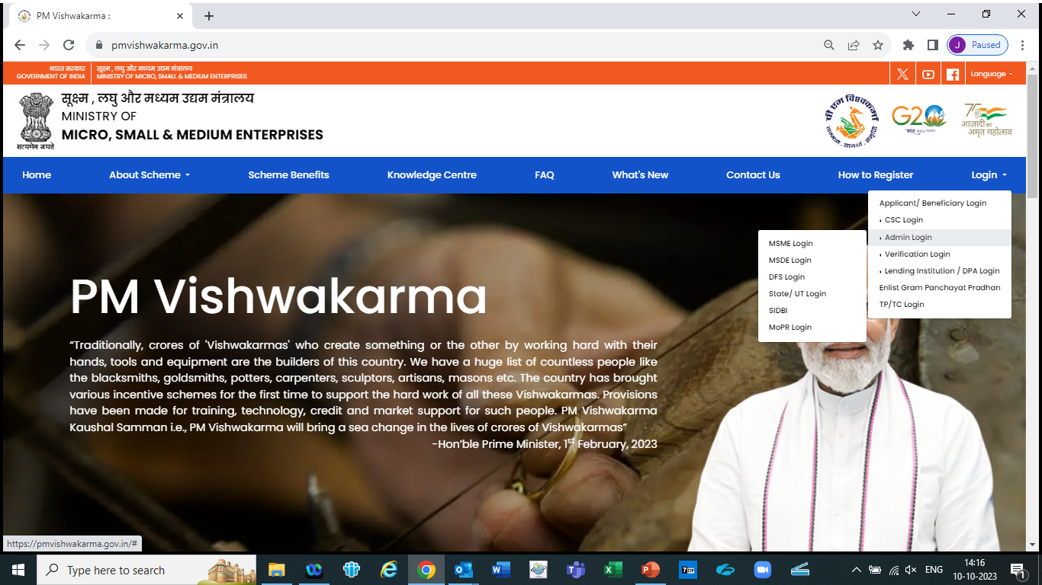

Slide 12
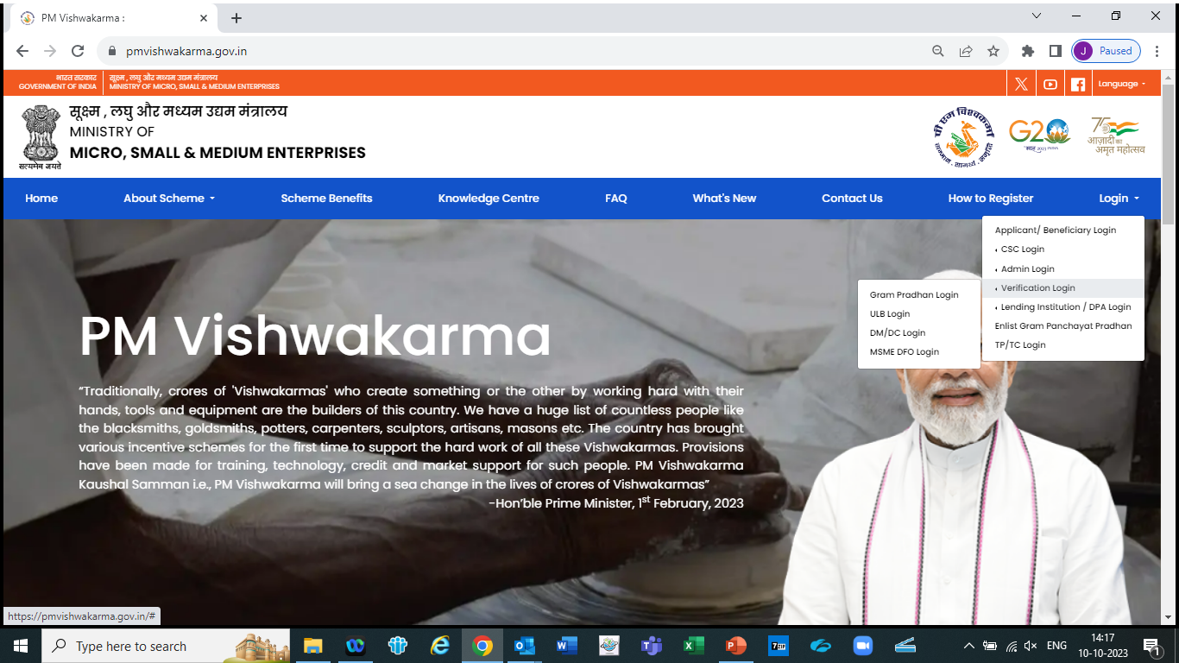

Slide 13
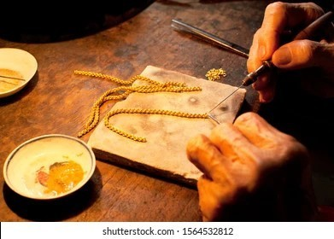
Thank You

